Slide 1
Wandering tales
Team united

Slide 2
AGENDA
Problem statement
Project Overview
Your solution and its proposition
Who are the end users
Modelling
The wow in your solution
Results

Slide 3
PROBLEM STATEMENT
The website is for helping people who have no idea about unknown places and unknown food because we people facing many problems as a new comer in new places so this website is specially useful for them.
Our website takes pride in showcasing lesser-known places that are off the beaten path.

Slide 4
PROJECT OVERVIEW
Discover
Discover hidden gems in towns and cities with our website, offering unique experiences and authentic cuisine.
Explore
Explore lesser-known places, discover hidden gems, and indulge in authentic dishes.
Experience
Experience a journey of exploration, culture, and gastronomy like never before with our user-friendly and intuitive website.

Slide 5

YOUR SOLUTION AND ITS VALUE PROPOSITION
Our website is your ultimate guide to uncovering the hidden gems of any town or city. Whether you're a seasoned traveler or a curious newcomer, we've got you covered with hidden gems.
Our website takes pride in showcasing lesser-known places that are off the beaten path.

Slide 6
Who are the end user
The end users are specially tourist and our new visitors outsiders citizens etc.

Slide 7
MODELLING
Wandering Tales of Kolkata
HOME
ABOUT US
PLACE
CUISINE
CONTACT
INTRODUCTION
HERITAGE PLACES
HERITAGE FOOD

Slide 8
THE WOW IN YOUR SOLUTION
Our website aims to introduce you to unique things of Kolkata.
01
From seeking unique adventure or local looking to discover hidden gems in Kolkata city.
03
We have curated a list of delighted famous foods .
02

Slide 9
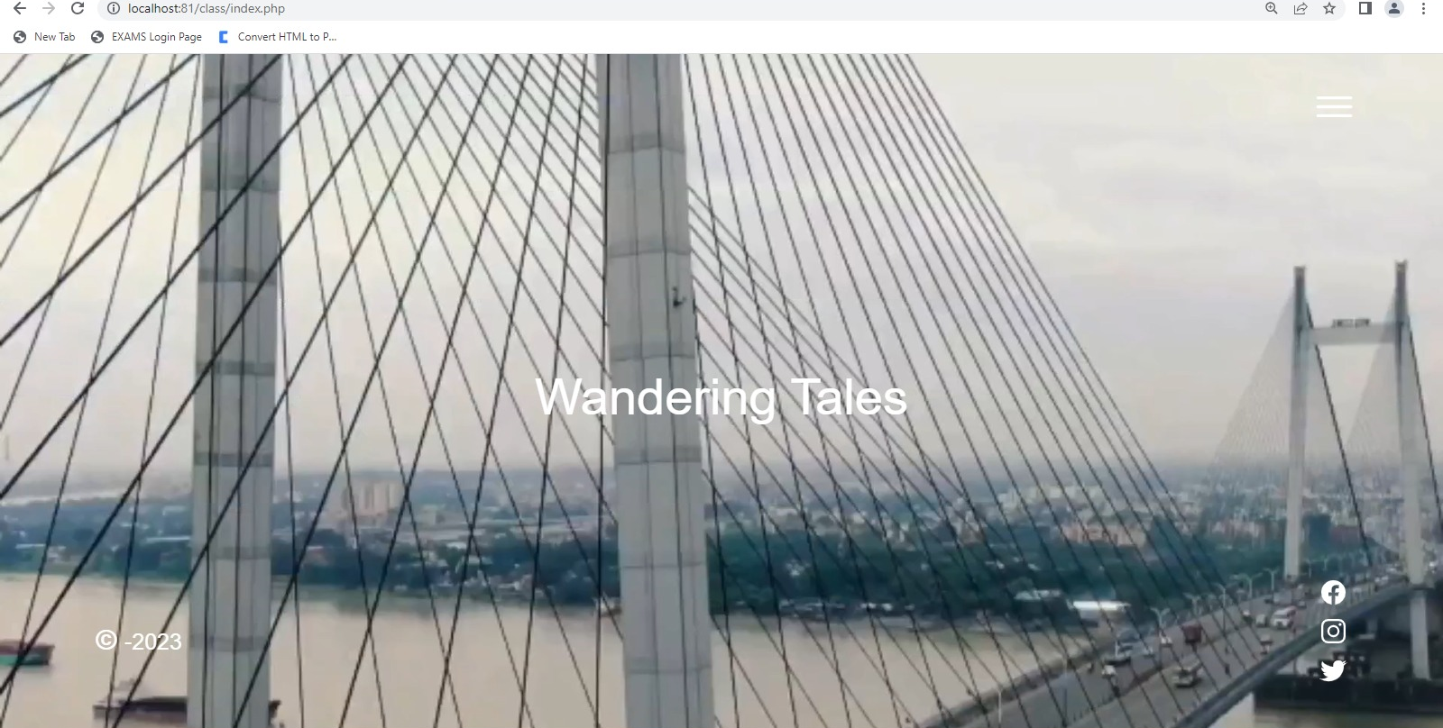
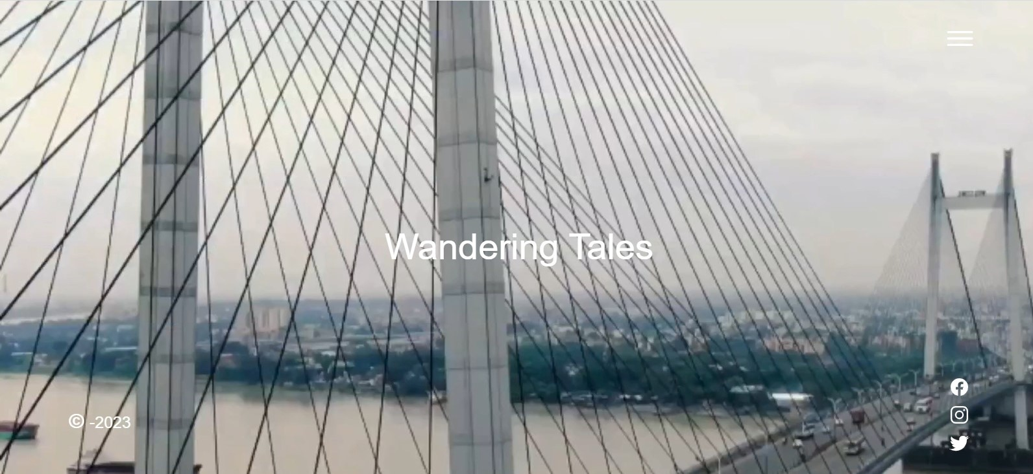
RESULTS
People can find heritage food and places through our website easily.

Slide 10
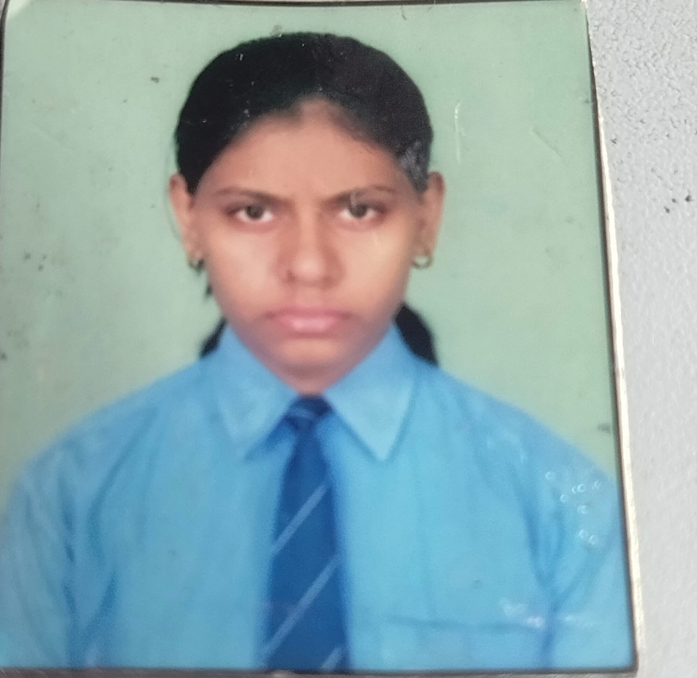
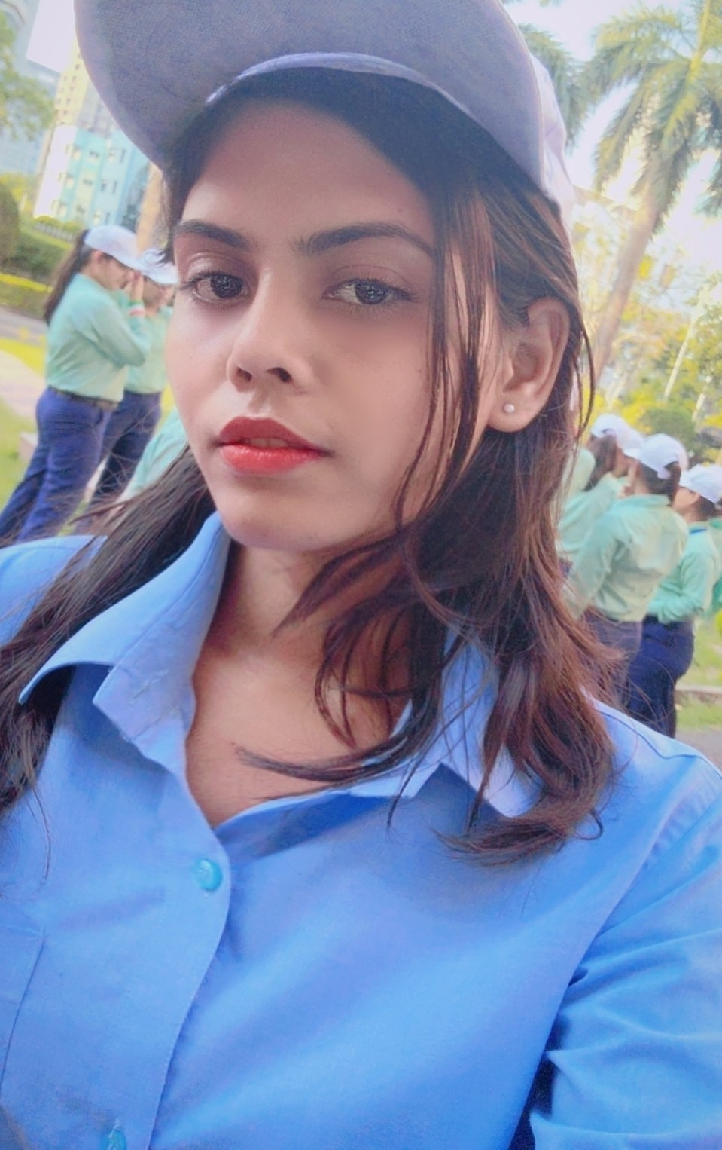

MEET OUR TEAM
Manjima Bhattacharyya
Aashika Raj
Srimana Maity

Slide 11

Thank you
This Photo by Unknown Author is licensed under CC BY-SA

